Slide 1
Chapter 1
Digital Image Processing

Slide 2

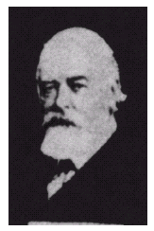
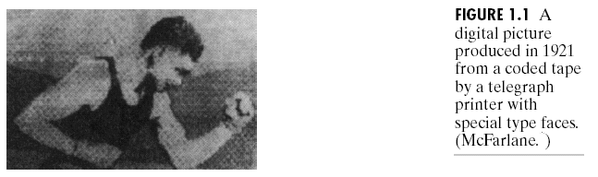
Digital Images in Early Era
1921 Telegraphing image
Printing industrial
Textile industrial
1922: image
from
Photographic
reproduction
Using punched
tape
These images are not computerized processed.
(Images from Rafael C. Gonzalez and Richard E.
Wood, Digital Image Processing, 2nd Edition.

Slide 3
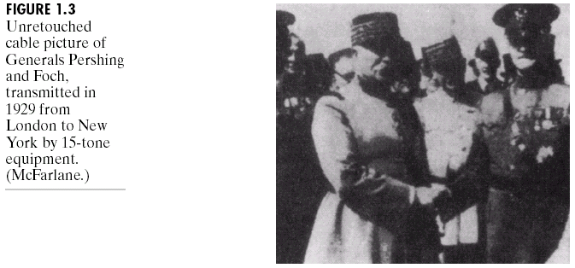
Digital Images in Early Era
(Images from Rafael C. Gonzalez and Richard E.
Wood, Digital Image Processing, 2nd Edition.

Slide 4
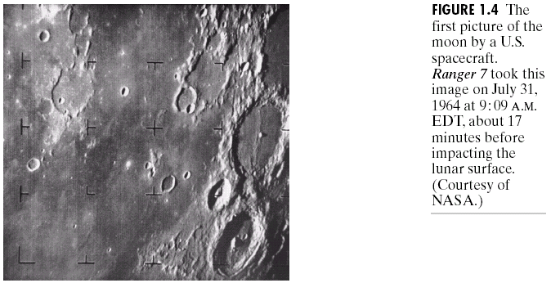
Digital Image Processing in Early Space Projects
(Images from Rafael C. Gonzalez and Richard E.
Wood, Digital Image Processing, 2nd Edition.

Slide 5
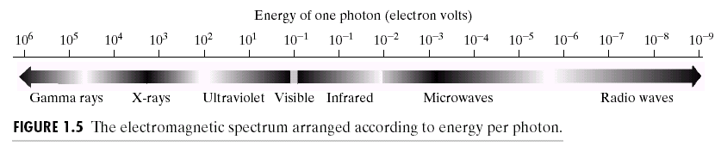
Energy Sources for Images
(Images from Rafael C. Gonzalez and Richard E.
Wood, Digital Image Processing, 2nd Edition.

Slide 6
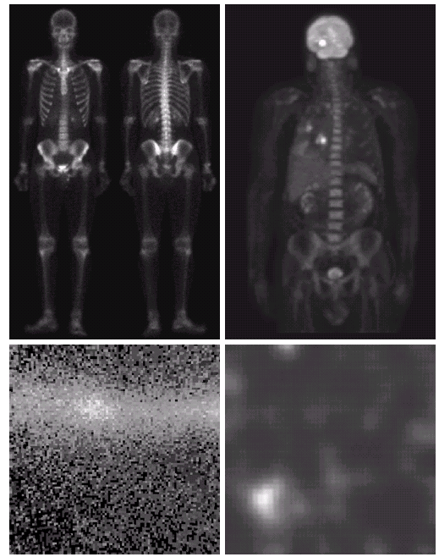
Gamma Ray
Bone scan
PET
External source
Radioactive
isotope decay
Internal Source
Positron emission
Star
Nuclear reaction
Cygnus loop
Reactor valve
(Images from Rafael C. Gonzalez and Richard E.
Wood, Digital Image Processing, 2nd Edition.

Slide 7
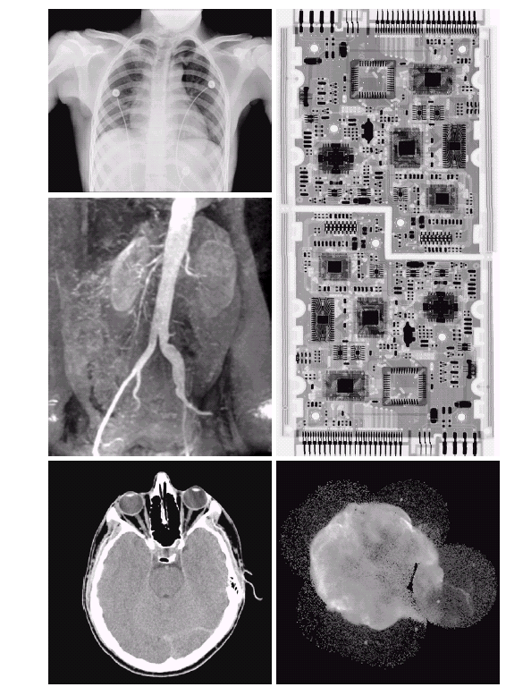
X-Ray
PCB
Chest
X-Ray
Angiogram
Source : X-Ray tube
Star
Nuclear reaction
Head CT
Cygnus loop
(Images from Rafael C. Gonzalez and Richard E.
Wood, Digital Image Processing, 2nd Edition.

Slide 8
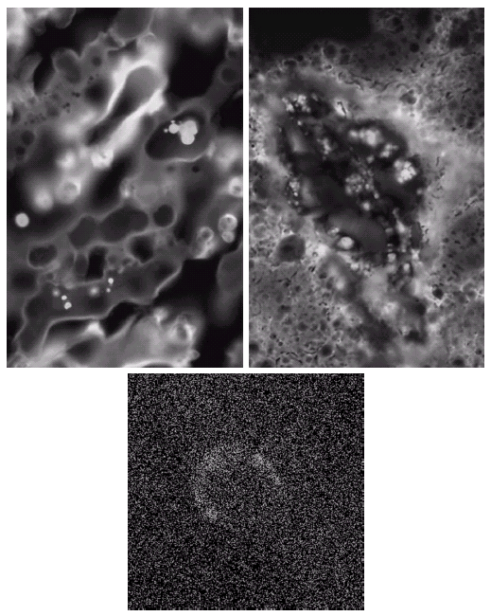
Ultraviolet
Normal corn
Smut corm
Fluorescence
phenomenon
Cygnus Loop
(Images from Rafael C. Gonzalez and Richard E.
Wood, Digital Image Processing, 2nd Edition.

Slide 9
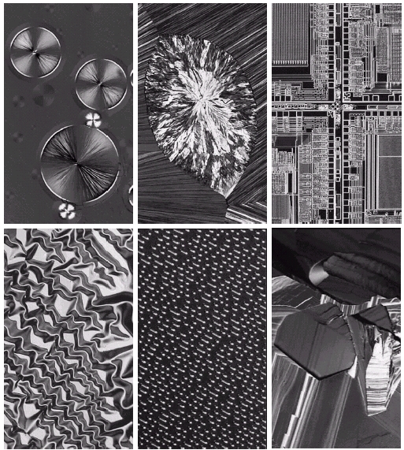
Visible Light and Infrared
Cholesterol
Taxol
Microprocessor
Organic
superconductor
Nickel oxide
Thin film
?
(Images from Rafael C. Gonzalez and Richard E.
Wood, Digital Image Processing, 2nd Edition.

Slide 10
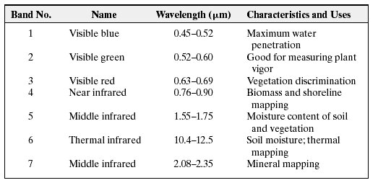
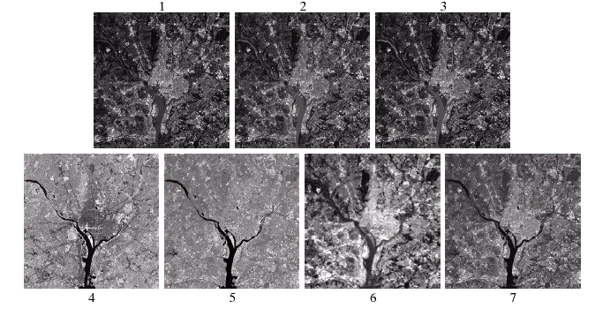
Visible Light and Infrared
Washington
D.C.
(Images from Rafael C. Gonzalez and Richard E.
Wood, Digital Image Processing, 2nd Edition.

Slide 11
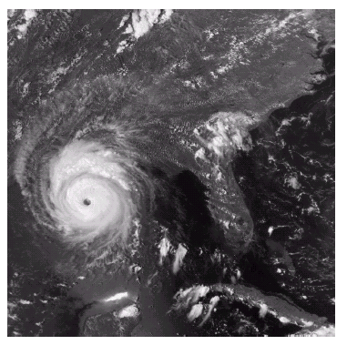
Multispectral Imaging
Hurricane Andrew
(Images from Rafael C. Gonzalez and Richard E.
Wood, Digital Image Processing, 2nd Edition.

Slide 12
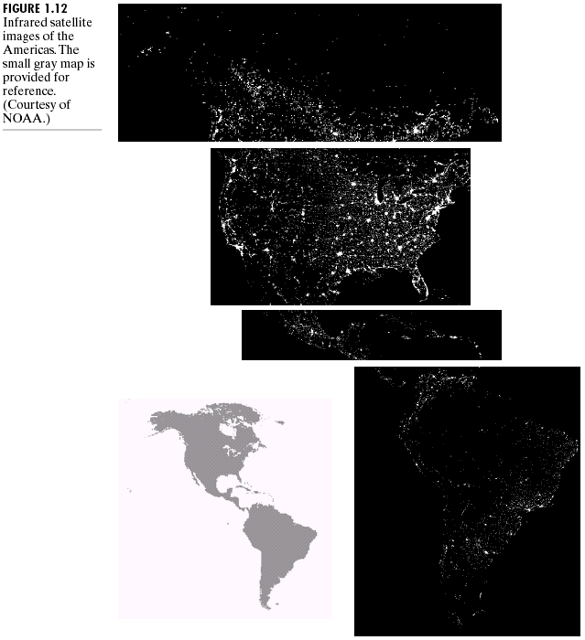
Nighttime light of the world
(Images from Rafael C. Gonzalez and Richard E.
Wood, Digital Image Processing, 2nd Edition.

Slide 13
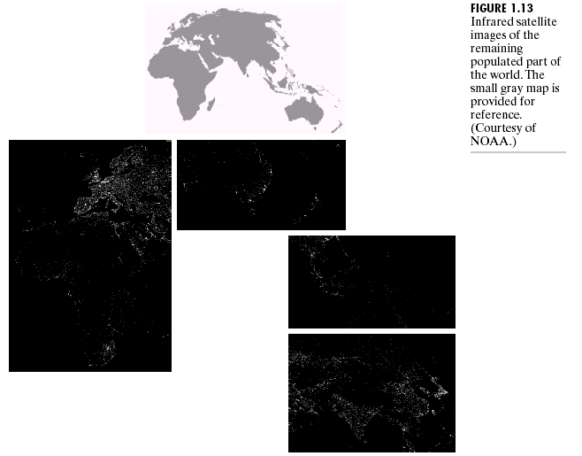
Nighttime light of the world (cont.)
(Images from Rafael C. Gonzalez and Richard E.
Wood, Digital Image Processing, 2nd Edition.

Slide 14
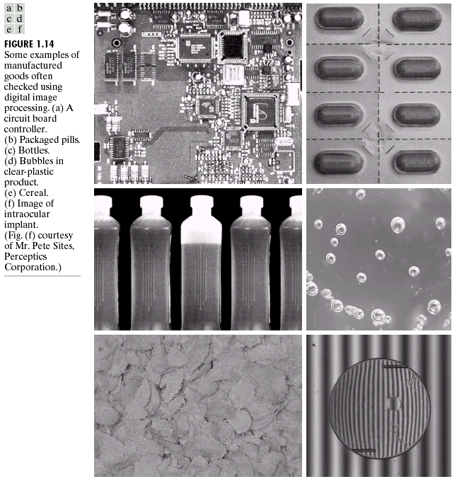
Automated Visual Inspection
(Images from Rafael C. Gonzalez and Richard E.
Wood, Digital Image Processing, 2nd Edition.

Slide 15
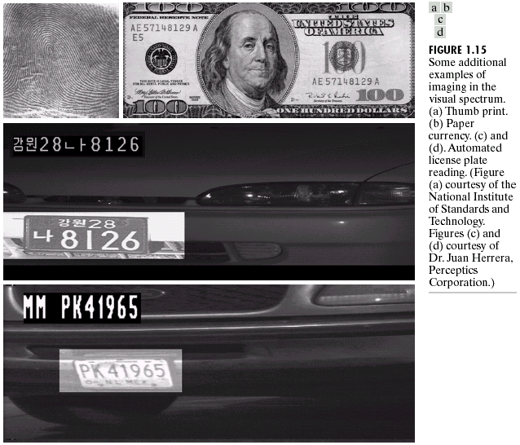
Automated Visual Inspection (cont.)
(Images from Rafael C. Gonzalez and Richard E.
Wood, Digital Image Processing, 2nd Edition.

Slide 16
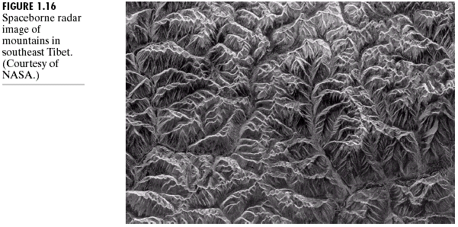
Microwave
Spaceborne Radar image
(Images from Rafael C. Gonzalez and Richard E.
Wood, Digital Image Processing, 2nd Edition.

Slide 17
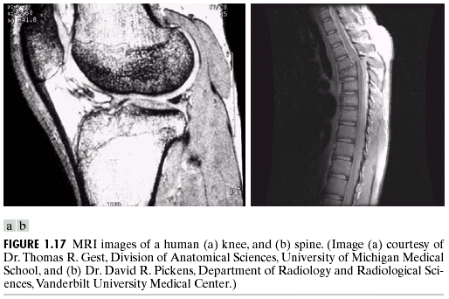
Magnetic
(Images from Rafael C. Gonzalez and Richard E.
Wood, Digital Image Processing, 2nd Edition.

Slide 18
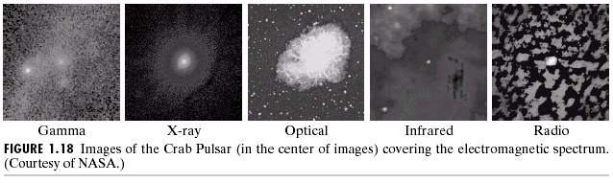
Multispectral images
(Images from Rafael C. Gonzalez and Richard E.
Wood, Digital Image Processing, 2nd Edition.

Slide 19
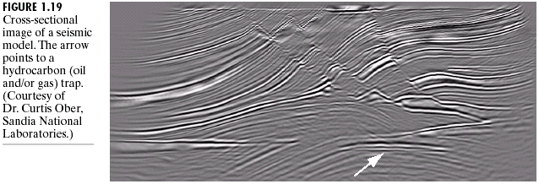
Seismic imaging
(Images from Rafael C. Gonzalez and Richard E.
Wood, Digital Image Processing, 2nd Edition.

Slide 20
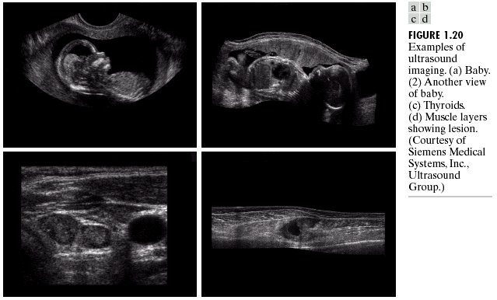
Ultrasound imaging
(Images from Rafael C. Gonzalez and Richard E.
Wood, Digital Image Processing, 2nd Edition.

Slide 21
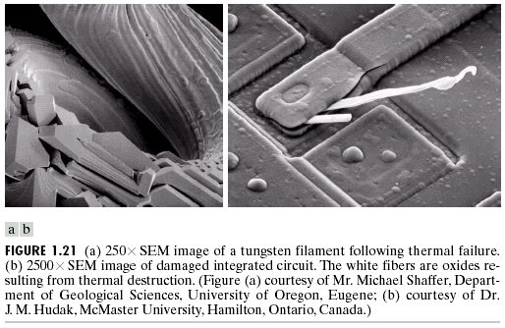
Electron Microscope Images
(Images from Rafael C. Gonzalez and Richard E.
Wood, Digital Image Processing, 2nd Edition.

Slide 22
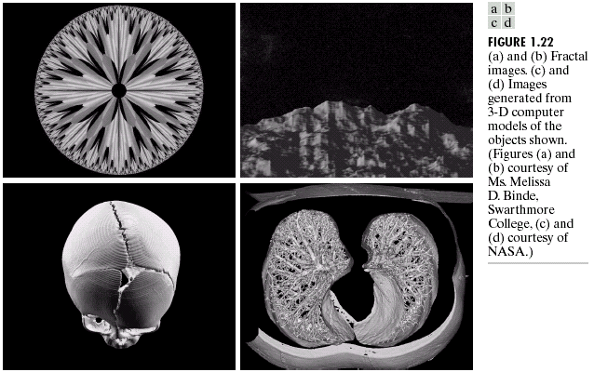
Synthesis Images
(Images from Rafael C. Gonzalez and Richard E.
Wood, Digital Image Processing, 2nd Edition.

